Slide 1

The Episcopal diocese of fort worth Bishop’s leadership workshop insurance and risk management Jim Dickenson, CIC market president FROST INSURANCE February 26, 2022

Slide 2
EDFW Insurance Program 2022
Comprehensive coverage terms and conditions (see handout)
Significant liability limits for The Diocese and all participating churches
Premium increases commensurate with the market conditions and EDFW claims experience
Property Insurance
Deductible is now $50,000 per claim – Church responsible for $10,000
Wind/Hail deductible – 3% of affected values subject to $250,000 minimum
Remarketing project underway – need some additional data from some churches
Excess of $4M in paid property claims - wind; hail; water; freeze
Our size allows us
to provide access to industry-specialized markets and premium carriers, offering you the best possible insurance options.

Slide 3
PROPERTY RISK MANAGEMENT
The Episcopal Diocese of Fort Worth
Facility Safety Inspection Checklist
Facility/Site Inspected: _________________________________________ Date: __________________
General Safety Inspection Completed by: __________________________________
Facility maintenance
Electrical
Plumbing
Lighting – Interior and Exterior
Security – Burglary/Fire/Smoke
Debris removal
Rodent and vermin control
Temperature control
Routine visual inspection of lesser used facilities
Our size allows us
to provide access to industry-specialized markets and premium carriers, offering you the best possible insurance options.

Slide 4
THE HARD MARKET
Hard Market Characteristics
Increased rates
More restrictive terms and conditions
Greater underwriting scrutiny
Hard Market Causes
Reduced investment income
Reduced interest rates
Increased claim and losses
Our size allows us
to provide access to industry-specialized markets and premium carriers, offering you the best possible insurance options.

Slide 5
Automobile
High severity potential
Social inflation significant
Costs for physical damage repairs increasing
Coverage for Owned; Hired; and Non Owned Autos
Non Owned Auto Coverage
Auto liability coverage for The Diocese and Churches if an employee or volunteer causes an accident while driving their own personal auto for church business
Why? Vicarious Liability – Being held responsible financially for the actions of others
Risk Management
MVRs must be checked at hire/volunteer application
MVRs should be checked annually
Acceptable vs Unacceptable (see handout)

Slide 6
Cyber/Privacy Liability
Market is extremely dynamic
Numbers and costs of claims have skyrocketed
Social Engineering Fraud
Phishing
Business Email Compromise
Ransomware
Coverage included in Church Mutual liability program
$100,000 Aggregate limit for cyber liability
$10,000 sublimit for regulatory defense and penalties
$20,000 sublimit for cyber extortion
$20,000 sublimit for first party data protection
$20,000 sublimit for first party network business interruption

Slide 7
Cyber/Privacy Liability
Privacy breach response services limits
$50,000 Aggregate limit for computer expert services; legal services; public relations and crisis management expenses
$10,000 Aggregate limit for expenses to notify individuals
Numbers and costs of claims have skyrocketed
Per claim retention $2,500
Risk Management
Diocesan Social Media policy
Data and server backups
Ongoing education to avoid “click bait”
Multi Factor Authentication
Safeguarding User ID’s and Passwords
Delete any email or text from unknown source
Never volunteer personal identifiable information without being certain the request is legitimate

Slide 8
Meet the Frost Insurance Risk Management and Service Team
Market President – Jim Dickenson, CIC
In-house Risk Control Specialist - Andy Johnson, ASC, SSH, CSHO
In-house Claims Specialist and Manager – Mark Strahan
Frost Client Resource Center Coordinator - Genevieve Salazar
Commercial Lines Services Manager – Nikki Adams, CIC, ACSR, PIWT, AIS, CISR, AINS

Slide 9

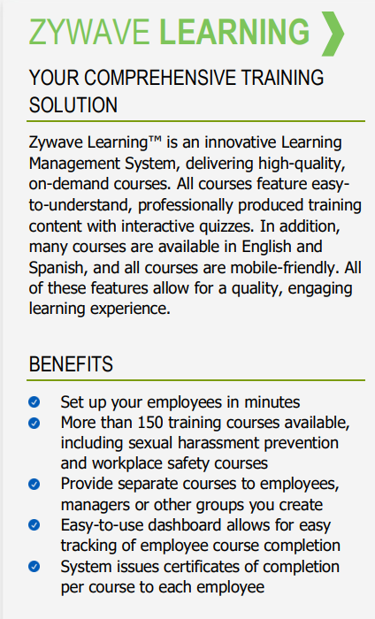
Suggested Zywave Learning TM Courses for
THE EPISCOPAL DIOCESE OF FORT WORTH
Cybersecurity – Data Privacy & Information Security
Defensive Driving Tips
Distracted Driving Prevention
Hang Up & Drive

Slide 10


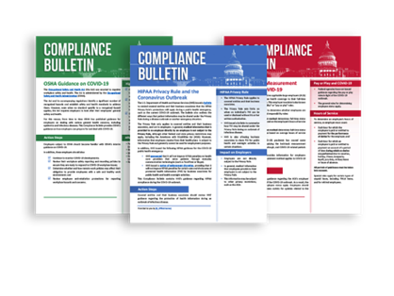
Zywave Resource Library
Employer Resources - thousands of employer-facing materials that can help you understand a number of topics. Whether you need tips to create the perfect workplace program or a guide on a new insurance topic, we have all of the easy-to-read resources to keep you updated.
Newsletters - Remaining informed on a variety of legislation and trending industry topics is easy with our regular newsletters. These newsletters feature concise summaries of rule changes and other topics to help you catch up with the latest information.
Compliance Bulletins - provide timely, essential information on the latest legal updates. These newsletters cover a variety of legislative topics, including health care law and federal agency health and safety standards.

Slide 11

Thank you!
Jim Dickenson
Market President | Frost Insurance
Frost – Banking, Investments, Insurance
640 Taylor St., Fort Worth, Texas 76102
Office: (817) 420-5701 | Cell: (817) 889-0221 | Fax: (817) 420-5750
jim.dickenson@frostinsurance.com | www.frostinsurance.com

