Slide 1
CERTIFICATES OF INSURANCE

Slide 2
Risk Management
Defined - Risk management is the process of identifying, assessing and controlling threats to an organization's capital and earnings. These threats, or risks, could stem from a wide variety of sources, including financial uncertainty, legal liabilities, strategic management errors, accidents and natural disasters. (www.whatis.com)
My definition – simply the process of identifying bad things that can happen to you and your parish/diocese that could cost you money – “risks”. Then, exploring techniques to reduce, control, eliminate or transfer those risks.

Slide 3
Do You Need a Certificate of Insurance?
What is a Certificate of Insurance?
Standardized document - provides evidence of insurance coverage – to be clear, it is NOT “proof” of insurance
Will include the contractor’s/service provider’s coverage types and liability limits
Certificate also lists the effective dates of the policy(s)
Why is a Certificate of Insurance important?
Confirms your contractor/service provider has assets (“insurance”) to protect against claims for Bodily Injury or Property Damage
Avoid circumstances where your parish/mission would otherwise be held liable for these damages
Supports the terms of your contract
Required coverage and limits
Required coverage terms and conditions

Slide 4
Do You Need a Certificate of Insurance?
When Should I Request a Certificate of Insurance?
Every time you or your parish/mission hires a contractor/or service provider
Even if a known contractor
Particularly important for work contractor performed on premises
Be sure to ask for a certificate of insurance before allowing contractors to work on your parish or mission property
For example, consider landscape services
Damage to property – 3rd parties or yours – cost of repairs
Bodily injuries – 3rd parties and/or contractor’s employees – medical bills

Slide 5
What should I look for on a Certificate of Insurance Form?
Not all certificates are valid – verify with insurance agent
Contractors may present false or forged information
Or may allow insurance to lapse after attaining the certificate of insurance form
Pay close attention
Confirm name of the insured on the form is an exact match for the name of the person or company you are hiring
Check policy coverage dates to ensure that they are valid
If the policy is due to expire before the job will be completed, you will need to be sure to get another certificate of insurance at that time
Ensure that the certificate holder has, at a minimum, both general liability insurance and workers compensation insurance
Confirm liability limits held by the contractor meet the minimum liability limits recommended by your Risk Management Committee
Ask to be named as an Additional Insured party for the duration of the project or contract for which you are hiring the contractor
Ask for a Waiver of Subrogation in your favor from the contractor and his/her insurance carriers

Slide 6
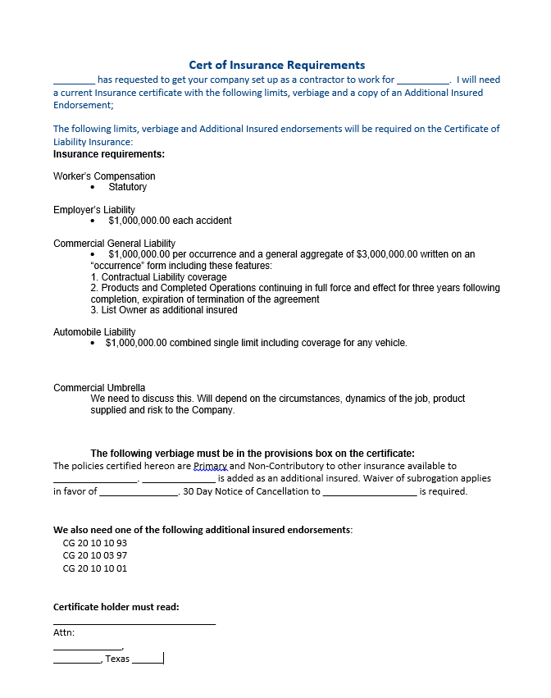
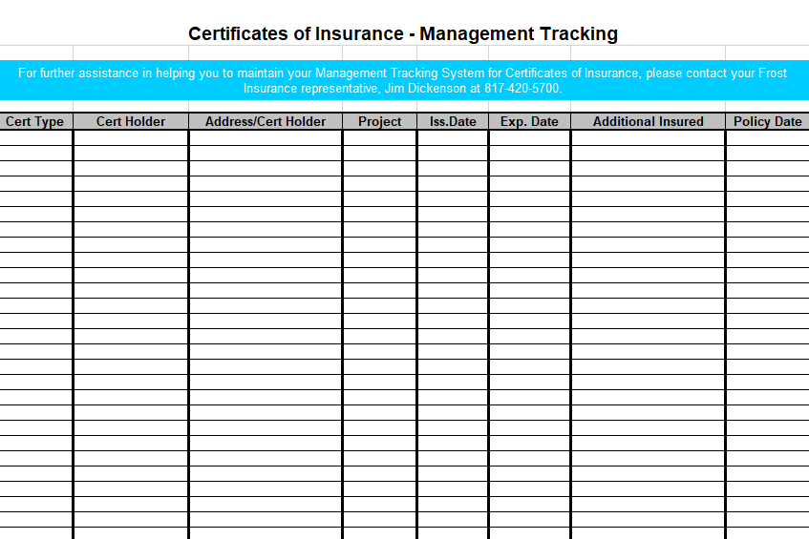
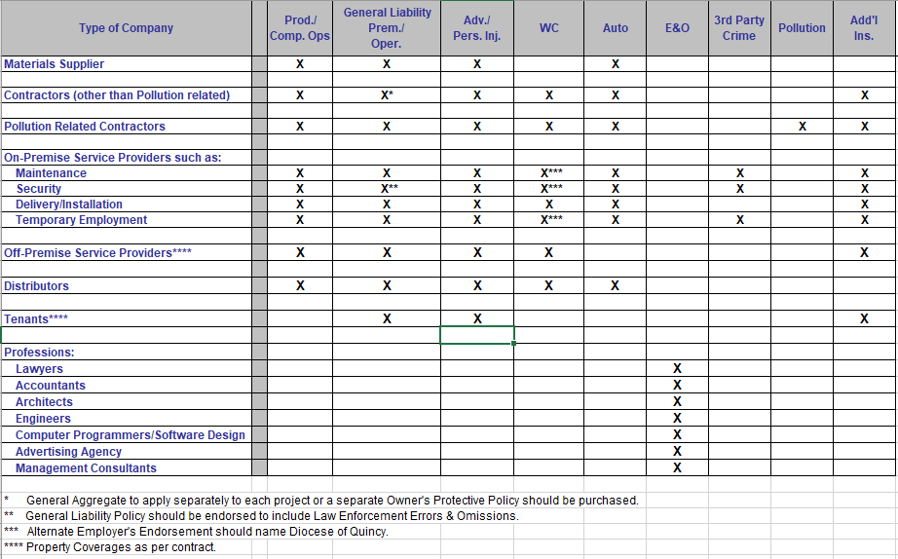
Certificate Management
Certificate of Insurance Request
Certificate of Insurance Requirements
Certificate of Insurance Tracking

Slide 7
Certificate of Insurance Request
Template document used to illustrate insurance coverage requested
May be customized to fit specific project/scope of work needs
Be prepared to negotiate
If the service provider does not have insurance, YOU are insuring their work

Slide 8
Certificate of Insurance Requirements
Visual reminder of insurance coverage typically needed for various service providers
Again, be prepared to negotiate

Slide 9
Certificate of Insurance Tracking
Simple spreadsheet used to track the receipt of insurance certificates
Use spreadsheet to track current certificates of insurance

Slide 10
Potential Financial Consequences
General Liability claims – for example:
Landscaping service by parish member
HVAC services by parish member
Additional Workers Compensation insurance costs at audit
Should obtain/retain a COI evidencing WC insurance from every on-premises contractor/service provider
If your chosen service provider/contractor does not have the requested insurance coverage, YOU are providing the insurance coverage

Slide 11
QUESTIONS – GIVE ME CALL AND LETS DISCUSS
JIM DICKENSON,CIC
SR. VICE PRESIDENT
FROST INSURANCE
jim.dickenson@frostinsurance.com
817.420.5701 office
817.889.0221 cell

