Slide 1
Notes & Permissions
The concepts in this presentation are the intellectual property of Spiritual Leadership Inc.
Copyright © 2016 Spiritual Leadership, Inc. All Rights Reserved.
This is a Beta Test version produced solely for the purpose of producing a final version. DO NOT begin using these slides in projects. A final approved version will soon be released that can be widely used.
All images:
Are licensed to be used or
Are believed to be fairly used under Creative Commons license or
We were given permission to use by image owner
No images should be used for any other purpose or sold without permission in order to avoid copyright infringement.

Slide 2

Reengaging Volunteers & Raising Up New Leaders Post-COVID February 2022
Notes:
Keys: take something with you into your Vestry meetings and congregation
Incorporate into real ministry
Themes:
Formation - formed to participate in mission
Adaptive leadership - why & how rather than just adjusting our what (technical)
Shared leadership

Slide 3
Introductions
What are your biggest challenges with reengaging volunteers post-COVID?
A different perspective on volunteers and raising up leaders.
Notes:
What if we had spiritual leaders rather than merely volunteers?
What if they were engaged with passion and utilizing their particular gifts, strengths, and experiences for the sake of God’s mission?
Long-term view vs. short-term view

Slide 4


Outcomes
…a consequence, effect, or outcome of something.
Practices
…a series of actions or steps taken in order to achieve a particular end.
Principles
…a fundamental truth or proposition that serves as the foundation for a system of belief or behaviors or for a chain of reasoning.
Notes:
Facilitator Notes
The SLI process results in a change of DNA, of environment, of culture. The SLI L3 culture is built upon sustainable underlying principles that do not change. Processes are the outflow of those principles, and these principles lead us to the results of Generative Ministry. Personal, Organizational and Community transformation will occur if we truly live into this L3 culture.
The L3 culture, that is based on principles which produce processes that create sustainable and generative results, will not only change the way we understand leadership, but also what true discipleship means. It’s so much more than doing, or actions. Its being and it’s abiding, then leading and living from there.
As the team explores this slide, share these thoughts, and ask their perspective – take the time to unpack these important pieces of the L3 culture. Be sure to share the principles and processes listed below when in your discussions, and make sure they know that each of these will be part of the process:
Most of the time we begin at results – looking for the outcome without paying much attention to what lies under those results. Much like the iceberg above what is where the attention is paid without realizing there is a much larger, wider one lying underneath.
Our perspective is a shift in how we look at the results we are hoping for. Taking the time, doing the hard work of identifying our driving principles, figuring out how they lead to what processes will insure definite, sustainable, results. This approach also creates accountability, as we are aware of how we obtained our desired results.
Some of the principles of the SLI process include:
Alignment with God
Mental Modes
Continuous Improvement
Root Cause
Missional Effectiveness Framework
Spiritual Formation
Trust Building
Community
Some of the processes of the SLI process include:
Covenant Accountability
Teams
Systems
Change Readiness
MAPs
Telescoped Strategies
RAD
The results we are looking for in our SLI process:
Generative Ministry
This slide is part of the review each month at the beginning of each session. Along the way, ask the Team how their understanding of these values has changed, what they see and hear differently as their journey progresses.
The concepts in this presentation are the intellectual property of Spiritual Leadership Inc., except as noted otherwise.
Copyright © 2016 Spiritual Leadership, Inc. All Rights Reserved.

Slide 5

Outcome: Engaged Volunteers & New Leaders Post-COVID

Slide 6

Principle Practice
Passionate spiritual leaders share and serve with the gifts God has given them.
Equipping and mobilizing disciples and spiritual leaders.
“So Christ himself gave… to equip his people for works of service, so that the body of Christ may be built up until we all reach unity in the faith and in the knowledge of the Son of God and become mature, attaining to the whole measure of the fullness of Christ.”
- Ephesians 4:11-13

Slide 7


Slide 8
Equipping Strategy
Intuitive/Haphazard
Intentional
Notes:
Programs to Spirit-led

Slide 9
Talk about it
Reflect together on how Jesus equipped the few.
What would have to change in your leadership culture in order to focus more on equipping and developing a few other leaders?
What would the fruit of this be?
Notes:
Why discipleship?
Why does it not happen?
How discipleship? (30,000 ft)
How spiritual formation? (on the ground)
Marsha comments
“Spiritual formation is often assumed but rarely practiced.”
Pseudo-discipleship happening in churches but discovery comes in simple but not easy Qs then stuff starts coming to surface – real discipleship.
Leadership can’t work until this stuff is dealt with. (immunity to change)

Slide 11
Formed in Christ to Join Christ in Mission

Slide 12

“Abide in me as I abide in you. Just as the branch cannot bear fruit by itself unless it abides in the vine, neither can you unless you abide in me. I am the vine, you are the branches. Those who abide in me and I in them bear much fruit, because apart from me you can do nothing. Whoever does not abide in me is thrown away like a branch and withers; such branches are gathered, thrown into the fire, and burned.”
^{NRS} John 15:4-6
Notes:
*
Facilitator Notes
Take some time to read the Scripture on the slide and perhaps even more of the passage in John 15:1-17. Discuss it as a group. What are the implications of this personally? What about corporately? It might even be helpful to count the number of times in these 17 verses that the words “abide,” “love,” and “fruit” appear. Quite revealing as one of the last messages Jesus gave his disciples before his crucifixion.
Purpose of slide:
This slide reminds us how our own intimate relationship with Jesus, abiding in his love, enables us to bear the fruit that glorifies God and reveals that we are true disciples of Jesus.
Message of slide:
The first 17 verses of John 15 are all part of a very important passage for SLI as we emphasize “abiding in Christ.” This particular part of the passage reminds us of how we are meant to BE and REVEAL the glory of God—by abiding as branches of the True Vine, and bearing (not producing on our own) much fruit that reveals his life and purpose for humanity as divine love flowing through our lives as his disciples, to the glory of God. This is a critical dimension of “the glory of God filling the earth as the waters cover the sea.” Verse 5 “apart from me you can do nothing” is a very important reminder to those of us who tend to place “doing” ahead of “being.” This could be a critical part of the discussion.
(4) Abide in me as I abide in you. Just as the branch cannot bear fruit by itself unless it abides in the vine, neither can you unless you abide in me. (5) I am the vine, you are the branches. Those who abide in me and I in them bear much fruit, because apart from me you can do nothing. (8) My Father is glorified by this, that you bear much fruit and become (or “prove to be”) my disciples.”
Stories: Maybe you have a short story of your own as to how this flow of Christ in your life as his branch first became a reality.
References:
The abiding is in Christ’s love. This can easily be forgotten and something else can be substituted. Ultimately, our task is one of intimacy with Jesus and his love (divine love) flowing into us and through us for fruitfulness in the world. Paul declares that his ultimate prayer for us is: “that according to the riches of his glory, he may grant that you may be strengthened in your inner being with power through his Spirit, and that Christ may dwell in your hearts through faith, as you are being rooted and grounded in love. . . . and to know the love of Christ that surpasses knowledge, so that ]you may be filled with all the fullness of God” (Ephesians 3:14-21).
In the words of Charles Wesley:
Love divine, all loves excelling,
Joy of heaven to earth come down,
Fix in us thy humble dwelling,
All thy faithful mercies crown!
Jesus, thou art all compassion,
Pure, unbounded love thou art;
Visit us with thy salvation;
Enter every trembling heart.
© 2013 Spiritual Leadership, Inc.

Slide 13
Principle Practice
God is present with us always – we can truly experience God’s grace and glory
Glory Sightings
“We have no design but to promote the glory of God.”
– John Wesley

Slide 14

“The glory that you have given me I have given them, so that they may be one, as we are one.”
^{NRS} John 17:22
Where have you seen God’s glory?
Notes:
*
Facilitator Notes
Purpose of slide:
The slide invites us to recall and tell the stories of our “glory sightings.”
Message of slide:
Take some time for the group to see where they have seen God at work. This simply works best by just asking where persons have seen God’s glory or God’s activity around them. This could be in a sunset, in their children, at work…anywhere. It is always a real encouragement to hear and be reminded that God is always at work if we will stop and pay attention.
To take this a bit further, Jesus prays in John 17 that the same glory he had received from his Father (John 1:14—”full of grace and truth”) was now given to his disciples to make them united (“one”) in purpose and in love. This is the glory of the NEW creation—”Christ in you, the hope of glory” (Colossians 1: 27), and the way God intends to have us witness to the world (John 17:23). This would be a good place to hear when people in the group have best seen this sort of “oneness” displayed by Jesus’ disciples.
A common and energizing response that has developed to each “glory sighting” shared is for the group to declare “GLORY!” You may want to illustrate and encourage others to join in after the first one or two stories.
After sharing together for a few minutes, take some time to pray as a group and give this journey to the Lord.
Stories:
References:
© 2013 Spiritual Leadership, Inc.

Slide 15
Principle Practice
Fruit through abiding in Christ and being Spirit transformed and empowered
Spiritual formation
“Spiritual formation is the process of being conformed to the image of Christ for the sake of others.”
- Mulholland, Invitation to a Journey

Slide 16


Spiritual Formation
“¹⁷Now the Lord is the Spirit, and where the Spirit of the Lord is, there is freedom. ¹⁸ And all of us, with unveiled faces, seeing the glory of the Lord as though reflected in a mirror, are being transformed into the same image from one degree of glory to another; for this comes from the Lord, the Spirit.”
^{NRS} 2 Corinthians 3:17-18
Notes:
*
Facilitator Notes
Purpose of the slide: To link our Formation disciplines to the biblical message and the work of the Holy Spirit in our lives.
Message of the slide: SLI’s investment in Spiritual Formation is tied directly to the good news that God intends through the Holy Spirit to transform us into the likeness of Jesus “from one degree of glory to another.” The Christ-likeness into which the Spirit brings us is divine love “full of grace and truth” (John 1:14)
Stories: Sometimes it’s helpful to remind each other that Christian salvation is not only “getting us into heaven, but also getting heaven into us.” Perhaps this is a good place for the facilitator to describe how this concept first began to grow in your own life.
John and Charles Wesley came to this transforming reality within a few days of each other in the spring of 1738 and then gave their lives and gifts to extend this possibility as the “Good Medicine of life.”
Charles Wesley described this in his hymn:
Love divine, all loves excelling, joy of heaven to earth come down;
Fix in us thy humble dwelling; all thy faithful mercies crown!
Jesus, thou art all compassion, pure, unbounded love thou art;
visit us with thy salvation; enter every trembling heart.
Finish, then, thy new creation; pure and spotless let us be.
Let us see they great salvation perfectly restored in thee;
changed from glory into glory, till in heaven we take our place,
till we cast our crowns before thee, lost in wonder, love, and praise.
References: Hymn: “Love Divine, All Loves Excelling” 1747
Image purchased from Lightstock (do not use without permission)
The concepts in this presentation are the intellectual property of Spiritual Leadership Inc., except as noted otherwise.
Copyright © 2016 Spiritual Leadership, Inc. All Rights Reserved.

Slide 17

Formation Guidelines
Only the Holy Spirit can bring transformation.
We are not here to fix one another.
Show respect for every individual in the group.
Answer in first person.
Write down requests for prayer.
Leaders are called to gently yet firmly apply means of accountability.
Notes:
*
Facilitator Notes:
Purpose of the slide: To introduce the covenantal nature and accountability dimensions of Spiritual Formation and lead toward the The Formation Question.
Message of the slide: Spiritual formation in SLI begins with a covenantal question that all L3 Project participants agree to answer and be held accountable to each time the Project meets. The question each person is asked to respond to, with varying wordings as we proceed, is, “What will I do to live in full devotion to Jesus Christ?”
In many ways this is the most fruitful time that you will spend during your Project. It’s exciting to see people challenge themselves and grow in spiritual disciplines, and in relationships with others and with God. Leaders in Projects (remember everyone in your Project is a leader!) are invited to ask the rest of the group to hold them accountable to what they request. Here are some examples of things people might say:
- I need to pray every morning. Please hold me accountable to praying 15 minutes every morning before I go to work.
- I haven’t been spending enough time with my son. Please hold me accountable for spending one evening a week with him doing something fun.
- I have not been spending enough time in sermon preparation. I always let other things take my time away from this. I need to spend all day on Tuesdays in sermon preparation and prayer.
- I have let myself go. I need to lose some weight and exercise. Please hold me accountable for walking for one hour four times a week.
Your notebook has a place to write each person’s name and his or her request. If you have a covenant to pray for each other, this is a quick way for people to keep track of the prayer requests of the group. Encourage leaders in the group to write down each request and pray concerning them before the next session.
At each session you will start this time by reviewing what people said the last time. As the facilitator, make sure you take good notes. After they report on their progress, they can take it off the list or add something else. For example, “Last time I talked about praying 15 minutes a day before going to work. It’s going well. I want to try 20 minutes.” Or, “My prayer time is not going well, I will try it again.”
Facilitate: You have 45 minutes for this time. As people get used to doing this, it is easy to lose track of time. If you have twelve people in your group, each person only has a few minutes to share. There will be times when someone needs more time. Your job will be to keep things moving and allow everyone time to share.
Before starting the process, go over the statements on the slides to establish the ground rules. As people share, help them follow the guidelines. There will be people who will want to offer advice and try to fix a problem; remind them that the goal is not to fix it but to allow room for God to influence the situation.
Share: As this is the first time, start out by sharing the kinds of requests people may make. Share what you want to focus on and then ask another person to share.
Stories:
References:
The concepts in this presentation are the intellectual property of Spiritual Leadership Inc., except as noted otherwise.
Copyright © 2016 Spiritual Leadership, Inc. All Rights Reserved.
.

Slide 18
Notes:
*
Facilitator Notes:
Purpose of the slide: Presents the Formation Question for this part of the journey and helps focus it on “actions” to commit to and be held accountable for, rather than just general areas of desire.
Message of the slide: The Formation Question is a covenantal question that all L3 Project participants agree to answer and be held accountable to each time the Project meets. The question each person is asked to respond to is, “What will I do to live in full devotion to Jesus Christ?”
See also notes for slide #4
Stories:
References:

Slide 19

Prayer Together
If fruit comes through our abiding in Christ together, how does this shape our intercession?
How does this inform how we recruit and develop volunteers and leaders?
Notes:
Remember that Jesus spent the night in prayer before recruiting his team.

Slide 20
Principle Practice
Prayer is powerful and effective.
Prayer for volunteers and leaders
“The prayer of a righteous person is powerful and effective.”
- James 5:16b
“One of those days Jesus went out to a mountainside to pray, and spent the night praying to God. When morning came, he called his disciples to him and chose twelve of them…”
- Luke 6:12-13

Slide 22
Adaptive Leadership
Notes:
Adaptive leadership - why & how rather than just adjusting our what (technical)

Slide 23
What to do post-COVID?
What has changed in our church since COVID?
What hasn’t changed?

Slide 24
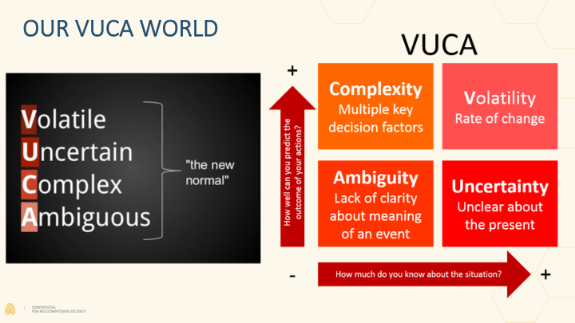
Notes:
contrast SLI with traditional strategic planning
paradigm shift of leadership is everywhere - need to lead together as we love & learn together
sweet spot now of opportunity
key of discernment - hear what the Spirit is saying to the church
why 'next steps' language so key for this season
God is doing something new - pay attention - don't miss it
moving from Judges to Acts
realistic: not fast, not a band-aid, tension, trust the process

Slide 25
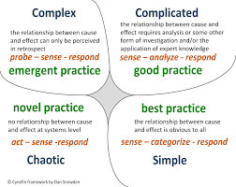
Cynefin Framework

Slide 26
Adaptive vs. Technical
Distinction between adaptive and technical
Who gets the work?
Role of the positional leader(s)?

Slide 27
Leading Adaptive Change
“Adaptive processes don’t require leadership with answers. It requires leadership that create structures that hold people together through the very conflictive passionate and sometimes awful process of addressing questions for which there aren’t easy answers.”
-Heifetz
Notes:
P 64

Slide 28
Adaptive Challenge
What is your greatest adaptive challenge?
How do you face them?

Slide 29
Have the Same Mind
If you have any encouragement from being united with Christ, if any comfort from His love, if any fellowship with the Spirit, if any tenderness and compassion, then make my joy complete by having the same mind, having the same love, being one in spirit and of one mind…Let the same mind be in you that was in Christ Jesus…
^{NIV} Philippians 2:1-2,5
Notes:
*
Facilitator Notes
Purpose of the slide: To link our Formation disciplines to the biblical message and the work of the Holy Spirit in our lives.
Message of the slide: SLI’s investment in Spiritual Formation is tied directly to the good news that God intends through the Holy Spirit to transform us into the likeness of Jesus “from one degree of glory to another.” The Christ-likeness into which the Spirit brings us is divine love “full of grace and truth” (John 1:14)
Stories: Sometimes it’s helpful to remind each other that Christian salvation is not only “getting us into heaven, but also getting heaven into us.” Perhaps this is a good place for the facilitator to describe how this concept first began to grow in your own life.
John and Charles Wesley came to this transforming reality within a few days of each other in the spring of 1738 and then gave their lives and gifts to extend this possibility as the “Good Medicine of life.”
Charles Wesley described this in his hymn:
Love divine, all loves excelling, joy of heaven to earth come down;
Fix in us thy humble dwelling; all thy faithful mercies crown!
Jesus, thou art all compassion, pure, unbounded love thou art;
visit us with thy salvation; enter every trembling heart.
Finish, then, thy new creation; pure and spotless let us be.
Let us see they great salvation perfectly restored in thee;
changed from glory into glory, till in heaven we take our place,
till we cast our crowns before thee, lost in wonder, love, and praise.
References: Hymn: “Love Divine, All Loves Excelling” 1747
Image purchased from Lightstock (do not use without permission)
The concepts in this presentation are the intellectual property of Spiritual Leadership Inc., except as noted otherwise.
Copyright © 2016 Spiritual Leadership, Inc. All Rights Reserved.

Slide 30
Empty Yourself
who, though he was in the form of God, did not regard equality with God as something to be exploited, but emptied himself, taking the form of a slave, being born in human likeness. And being found in human form, he humbled himself and became obedient to the point of
death—even death on a cross.
^{NRS} Philippians 2:6-8
Notes:
*
Facilitator Notes
Purpose of the slide: To link our Formation disciplines to the biblical message and the work of the Holy Spirit in our lives.
Message of the slide: SLI’s investment in Spiritual Formation is tied directly to the good news that God intends through the Holy Spirit to transform us into the likeness of Jesus “from one degree of glory to another.” The Christ-likeness into which the Spirit brings us is divine love “full of grace and truth” (John 1:14)
Stories: Sometimes it’s helpful to remind each other that Christian salvation is not only “getting us into heaven, but also getting heaven into us.” Perhaps this is a good place for the facilitator to describe how this concept first began to grow in your own life.
John and Charles Wesley came to this transforming reality within a few days of each other in the spring of 1738 and then gave their lives and gifts to extend this possibility as the “Good Medicine of life.”
Charles Wesley described this in his hymn:
Love divine, all loves excelling, joy of heaven to earth come down;
Fix in us thy humble dwelling; all thy faithful mercies crown!
Jesus, thou art all compassion, pure, unbounded love thou art;
visit us with thy salvation; enter every trembling heart.
Finish, then, thy new creation; pure and spotless let us be.
Let us see they great salvation perfectly restored in thee;
changed from glory into glory, till in heaven we take our place,
till we cast our crowns before thee, lost in wonder, love, and praise.
References: Hymn: “Love Divine, All Loves Excelling” 1747
Image purchased from Lightstock (do not use without permission)
The concepts in this presentation are the intellectual property of Spiritual Leadership Inc., except as noted otherwise.
Copyright © 2016 Spiritual Leadership, Inc. All Rights Reserved.

Slide 31
Book of Acts
“Therefore, friends, select from among yourselves… full of the Spirit and of wisdom…”
^{NRS} Acts 6:3
“For it has seemed good to the Holy Spirit and to us…”
^{NRS} Acts 15:28
Notes:
*
Facilitator Notes
Purpose of the slide: To link our Formation disciplines to the biblical message and the work of the Holy Spirit in our lives.
Message of the slide: SLI’s investment in Spiritual Formation is tied directly to the good news that God intends through the Holy Spirit to transform us into the likeness of Jesus “from one degree of glory to another.” The Christ-likeness into which the Spirit brings us is divine love “full of grace and truth” (John 1:14)
Stories: Sometimes it’s helpful to remind each other that Christian salvation is not only “getting us into heaven, but also getting heaven into us.” Perhaps this is a good place for the facilitator to describe how this concept first began to grow in your own life.
John and Charles Wesley came to this transforming reality within a few days of each other in the spring of 1738 and then gave their lives and gifts to extend this possibility as the “Good Medicine of life.”
Charles Wesley described this in his hymn:
Love divine, all loves excelling, joy of heaven to earth come down;
Fix in us thy humble dwelling; all thy faithful mercies crown!
Jesus, thou art all compassion, pure, unbounded love thou art;
visit us with thy salvation; enter every trembling heart.
Finish, then, thy new creation; pure and spotless let us be.
Let us see they great salvation perfectly restored in thee;
changed from glory into glory, till in heaven we take our place,
till we cast our crowns before thee, lost in wonder, love, and praise.
References: Hymn: “Love Divine, All Loves Excelling” 1747
Image purchased from Lightstock (do not use without permission)
The concepts in this presentation are the intellectual property of Spiritual Leadership Inc., except as noted otherwise.
Copyright © 2016 Spiritual Leadership, Inc. All Rights Reserved.

Slide 32
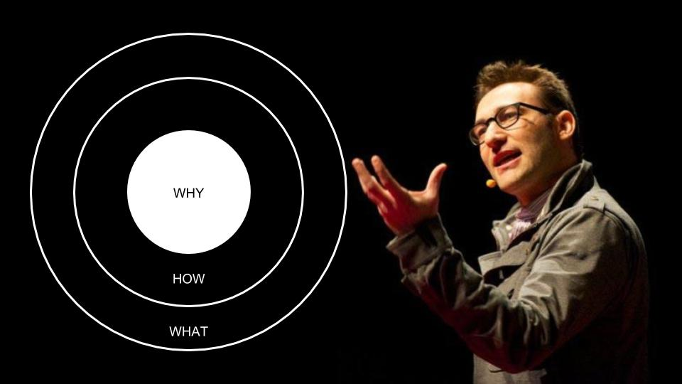
Focus on your ‘why’ together
Typical COVID response: treat adaptive challenges like technical ones (relied on experts)
Adapt our ‘how’ based on our ‘why’ rather than just adjusting our ‘what’ (we start with ‘why’)

Slide 33
Adaptive Leadership – Core Processes
On the Balcony (See & Discern)
Observation
Interpretation
Design Intervention
On the Playing Field
Experiment
Continual Improvement

Slide 34
What to do post-COVID?
What has changed in our church since COVID?
What hasn’t changed?
What should never change?
What can we change?

Slide 36
Shared Spiritual Leadership

Slide 37
Consulting Scripture
The Trinity
Moses & Jethro
Jesus with the Twelve
Early Church (Acts 2-6,15)
Paul & proteges & elders
Relationship (love) &
Responsibility (purpose)
Notes:
*
Facilitator Notes
Purpose of the slide: To link our Formation disciplines to the biblical message and the work of the Holy Spirit in our lives.
Message of the slide: SLI’s investment in Spiritual Formation is tied directly to the good news that God intends through the Holy Spirit to transform us into the likeness of Jesus “from one degree of glory to another.” The Christ-likeness into which the Spirit brings us is divine love “full of grace and truth” (John 1:14)
Stories: Sometimes it’s helpful to remind each other that Christian salvation is not only “getting us into heaven, but also getting heaven into us.” Perhaps this is a good place for the facilitator to describe how this concept first began to grow in your own life.
John and Charles Wesley came to this transforming reality within a few days of each other in the spring of 1738 and then gave their lives and gifts to extend this possibility as the “Good Medicine of life.”
Charles Wesley described this in his hymn:
Love divine, all loves excelling, joy of heaven to earth come down;
Fix in us thy humble dwelling; all thy faithful mercies crown!
Jesus, thou art all compassion, pure, unbounded love thou art;
visit us with thy salvation; enter every trembling heart.
Finish, then, thy new creation; pure and spotless let us be.
Let us see they great salvation perfectly restored in thee;
changed from glory into glory, till in heaven we take our place,
till we cast our crowns before thee, lost in wonder, love, and praise.
References: Hymn: “Love Divine, All Loves Excelling” 1747
Image purchased from Lightstock
The concepts in this presentation are the intellectual property of Spiritual Leadership Inc., except as noted otherwise.
Copyright © 2016 Spiritual Leadership, Inc. All Rights Reserved.

Slide 38
So… why teams?
Biblical model.
Overcoming adaptive challenges requires shared leadership.
Notes:
contrast SLI with traditional strategic planning
paradigm shift of leadership is everywhere - need to lead together as we love & learn together
sweet spot now of opportunity
key of discernment - hear what the Spirit is saying to the church
why 'next steps' language so key for this season
God is doing something new - pay attention - don't miss it
moving from Judges to Acts
realistic: not fast, not a band-aid, tension, trust the process

Slide 39
Cultivating Environments Roxburgh
“…recognition that leadership in the local church is less and less about creating and managing programs and then trying to get people into them and more and more about creating the environments that foster interconnections and conversations among people.” (169)
Notes:
Quote #1 from “Missional Map-Making”
Quote #2 from “The Missional Leader”

Slide 40
Team =
Team =
Relationship/Formation
Mission Together
Notes:
Facilitator notes
We define team as the best of both worlds coming together – where people live life deeply with one another in pursuit of Christ and in pursuit of a common mission or purpose. This combines the relational/formational aspects of small groups with the task/purpose aspects of committees. Ask people to share their thoughts and reflections. Have you ever thought of teams in this way? Think about the implications of this: instead of having separate committees and small groups to attend for each person, what if each person had that main place where he/she plugged in that met both purposes? Would this keep us from having such a bifurcation between tasks and relationships? What other implications are there? What about people who don’t like one or the other – would this stretch them? Have folks share thoughts. Remember to use the question to draw discovery out of the participants rather than just tell them all the answers. As a facilitator, you are a co-learner here.
Stories
References
The concepts in this presentation are the intellectual property of Spiritual Leadership Inc., except as noted otherwise.
Copyright © 2016 Spiritual Leadership, Inc. All Rights Reserved.

Slide 41
Who is your WE?
Do you have team?
Do you share purpose with passion?
Do you have trust and accountability?

Slide 42





Principle Practice
Unity is God’s design.
Overcoming adaptive challenges requires shared leadership (team).
New Team
Startup
Notes:
Purpose of slide: This module outlines the full startup process for an Operational Team – the details follow.
Overview for everyone – help all see the big picture and see themselves starting a new team.
Specific plan for new team leader – steps and tools are provided in this section for new team leaders to follow to start healthy Operational Team environments and relationships.
Message of slide: Some teams that need to be operational may need to begin at less than ‘full commitment’ and discover as they go that they need more time and energy around trust building, open dialog, seeing the vision, etc. If so, just have this team and the new team leader/connector keep the goal clearly in mind and keep working toward the type of team they need to become.
Regardless of this, the principles which follow apply to beginning any type of team; it’s the depth to which the principles and processes are taken which vary by the type of team and the type of work involved.
So a main point to keep in mind is not overwhelming potential leaders with the challenges of starting a new team but rather encouraging them to apply these principles as well and fully as they can, given the purpose of the team to be created.
Quick outline of this module:
1. Clear Purpose: Identify the purpose from the MAP: shift strategy from parent MAP to purpose/mission of child MAP. From the purpose and its scope, determine if the work will be technical, adaptive, or a mix. From this determine the type of team – task, operational, hybrid. We are assuming that the original parent team is launching this new team, which means the purpose of the new team is given. If this process is used generally to launch a new team without a given purpose already, then the purpose will need to be clarified before the team is built.
2. Right Leader: Select the right Leader – this is likely a member of the parent team with passion, will, and skills to be the new team leader. If the right person is not on this team, either add him/her to the team or identify a team member with passion for the purpose and assign them as ‘connector’ – the person on both teams to serve as ‘proxy’ for the leader on this team.
3. Right Team: Select and Recruit the Right Team – principles of gift-based leadership and setting high expectations.
4. Healthy DNA: Principles and practices to include. For an operational team, include the following as a minimum from this team’s ‘DNA’:
L1 – Loving God and Others: Formation, covenant – team living in covenant and growing in Christ is foundational
L2 – Learning: focus on Leadership and topics around the team’s purpose – learning about self and the purpose/focus of the team
L3: Child MAP. The parent team provides a skeleton draft of a child MAP to get the new team started – by doing the draft, the parent team learns how this works, provides a start to the child MAP for the new leader/team, and sets a framework for RAD between new/child team leader and parent team.
Adaptive/Technical: child team will begin more in ‘cycle 2’ mode than cycle 1– building its foundation and beginning actions/operations at the same time.
5. Strong Start: Set up first meeting – set expectations well from the get-go, overcoming fears for finding the ‘right people’. Set up for accountability (RAD) – set up clear connections and expectations from the get-go.
Stories
References
The concepts in this presentation are the intellectual property of Spiritual Leadership Inc., except as noted otherwise.
Copyright © 2016 Spiritual Leadership, Inc. All Rights Reserved.
.

Slide 43
Practicing L3 with a Team
On the Playing Field
Loving
Glory sightings
Learning
Clarifying our ‘why’ (values, mission, vision)
Leading
Experimenting
Accountability
Prayer
Clarifying current reality
Continual Improvement
On the Balcony
On our Knees

Slide 44

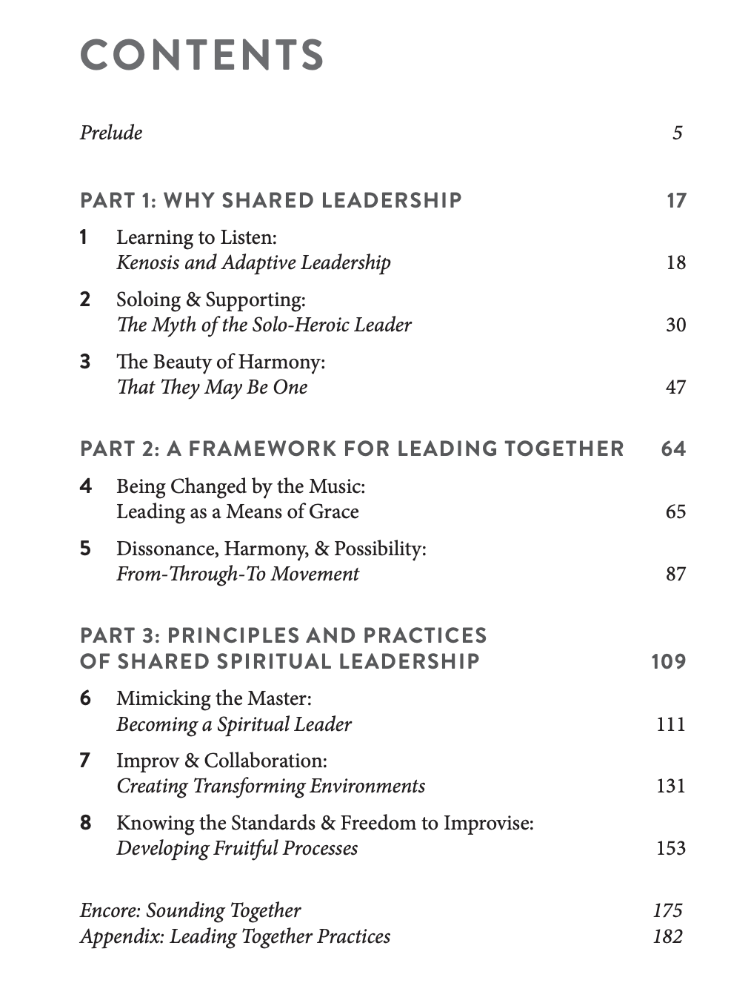

Slide 45
Q&A

Slide 46
Contact Information…
Name: Bryan D. Sims
Email: bryan.s@spiritual-leadership.org
Phone: (859) 229-4143
Org Website: www.spiritual-leadership.org
Personal Website: www.bryandsims.com
Notes:
The concepts in this presentation are the intellectual property of Spiritual Leadership Inc., except as noted otherwise.
Copyright © 2016 Spiritual Leadership, Inc. All Rights Reserved.

Slide 47
Reengaging Volunteers & Raising Up New Leaders Post-COVID February 2022
Notes:
Keys: take something with you into your Vestry meetings and congregation
Incorporate into real ministry
Themes:
Formation - formed to participate in mission
Adaptive leadership - why & how rather than just adjusting our what (technical)
Shared leadership

Slide 48
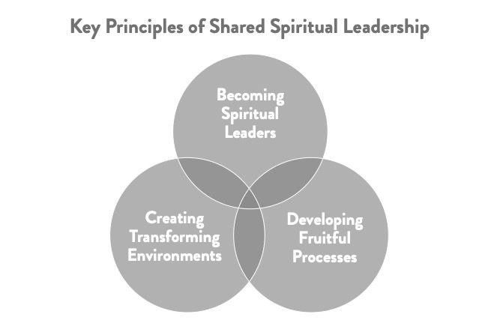

Slide 49
3 Types of Accountability
Formational (Spiritual Formation)
Relational (Covenant)
Missional (MAP & RAD)

Slide 50
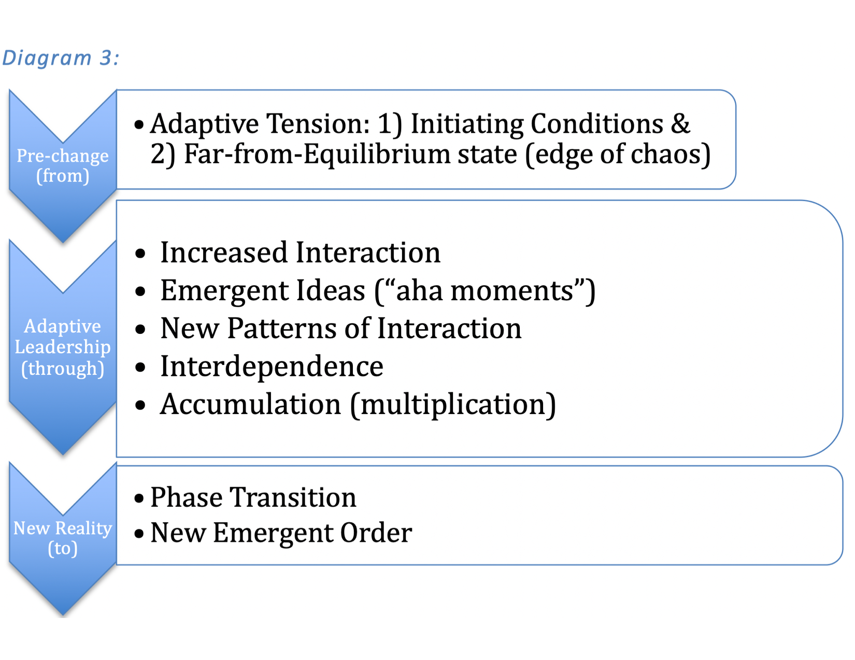

Slide 51
Creating Capacity
If you need more capacity, how create more?
Get better at something (more effective & more efficient; learning to prioritize)
Give something away (delegate)*
Tasks
Responsibility
Authority
Create systems for multiplication
*Delegation often requires equipping/empowerment
Notes:
*Work Avoidance can fit into here too. Not getting caught in the whirlwind of the day-to-day and remaining focused on what is most important. (“Eat the frog first”)
Ex. If we don’t have a bulletin this week, is anyone even going to notice?

Slide 52




Disciple Making System
1
4
2
3
Notes:
This is a cycle, and Send overlaps with Engage. Being sent forth often results in engaging new persons and leading them to Christ and to becoming equipped, and sent, and engaging, and…
Stories
References
The concepts in this presentation are the intellectual property of Spiritual Leadership Inc., except as noted otherwise.
Copyright © 2016 Spiritual Leadership, Inc. All Rights Reserved.

Slide 53
Church System
Passionate Spiritual Leaders
Capacity Generating
System
Vital Ministry
System
Leadership System
Passionate Spiritual Disciples
Generative Ministries
Disciple Making
System
Disciple Making System
Notes:
A PSD is accountable spiritually and missionally to working their calling
A PSD who is exploring or living as a leader
Vital Ministries are designed to grow as connected generative frameworks

Slide 54
A Framework for Vitality
Leadership: Clergy & Lay
Church Vitality
Disciple Making in the Local Church
Transforming
the World

Slide 55

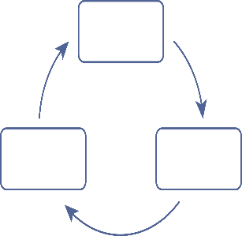

This ministry team will…
Bring joy and focus to your ministry while being and making disciples.
Reflect
Do
Adjust
Align Ministry: Adaptive Plan
Overcome Distractions
Move towards mission
Overcome frustration
Build a Team
Overcome Isolation
Notes:
Facilitator Notes
This slide will be used throughout our process as an overview of the SLI process. It will be a kind of compass as to where we are in a particular section of the process. When it appears, it indicates a place to stop and remind the team where we are and what the purpose of the section they are moving to.
Remember that you are a guide who is helping this team move towards their Mission.
When working the L3 process and implement and practice of the L3 process, your team find joy and focus as you are being and making disciples:
Building a team will help overcome the isolation of solo heroic leadership and program driven ministry
Aligning your ministry through an adaptive plan will help overcome the distractions of non mission focused programs and activities
Moving towards your identified mission will help in overcoming the frustration caused by lack of mission alignment and focus.
The team will work to identify the problem, and through the L3 process obtain the steps and strategies to overcome it. The process of continual improvement (Reflect, Adjust, Do) will maintain the momentum and generative multiplication of the identified mission.
If needed for definition of each section:
This ministry team will develop a new environment for being and making disciples
Build a Team:
Works to build this team of spiritual leaders (becoming like Jesus) who are Loving, Learning, and Leading together in covenant.
The team will use the L3 process
Loving God & Neighbor through spiritual formation & worship
Formation - the process of being conformed to the image of Christ, a servant of others for the sake of God’s mission. Individuals are asked to share their journey and relationship with God.
Learning through
Personal and organizational examination
Ministry Action Planning
Reading and study of materials together
Leading by
Participation in or development of a team
Participation in building a Ministry Action Plan
Implementation of the Ministry Action Plan developed by the team
Design a Generative System:
Clarifies our Values, Mission, and Vision (Focus)
Develops MAP (Ministry Action Planning) answering:
Who are we?
Where are we?
What is God calling us to?
How do we get there?
Move towards mission:
The SLI L3 culture is built upon sustainable underlying principles that do not change.
Processes are the outflow of those principles that don’t compromise principles and lead us to the results of Generative Ministry. Personal, Organizational and Community transformation will occur if we truly live into this L3 culture.
The impact from these principles and processes is the movement toward the identified Mission. The continual improvement and action will increase and insure this movement toward the identified Mission.
The outcome of moving towards the identified Mission include:
An environment where persons can be and can make disciples.
Discovering Adaptive Solutions
Creating Generative Ministry
Establishing Accountability
Committing to bringing transformation to both the church and the community by putting the MAP into action
The concepts in this presentation are the intellectual property of Spiritual Leadership Inc., except as noted otherwise.
Copyright © 2021 Spiritual Leadership, Inc. All Rights Reserved. Version 6.0
55

Slide 56

Where is God leading us?
How will we get there?
Where are we now…really?
Why do we exist?
What is too important to compromise?
Notes:
Facilitator Notes
Developing their MAP (Ministry Action Planning) answering (from the bottom up):
What is important too important to compromise?
Why do we exist?
Where are we now…really?
Where is God leading us?
How will we get there?
This is an introductory slide to the MAP (Ministry Action Plan) Don’t get caught up in trying to explain the complexity of the MAP, but rather paint a broad stroke picture of the process and the key 5 questions at this point. Reassure them that they will have time and good instruction/learning about each of these as the process continues. Each of these sections (Context, Vision, Focus, Systems/Strategies) have a specific Learning component.
The Ministry Action Plan is a simple format. There are just 5 different key areas: building the right type of team, understanding the context or the existing reality, knowing what your focus is, building a system to reach towards a vision, and then putting it into practice.
Spend a few minutes actually answering the questions as it relates to their ministry. Again, paint the picture that together they will discern the answers to these questions, but do not have to have the answers at this point.
The concepts in this presentation are the intellectual property of Spiritual Leadership Inc., except as noted otherwise.
Copyright © 2016 Spiritual Leadership, Inc. All Rights Reserved.

Slide 57
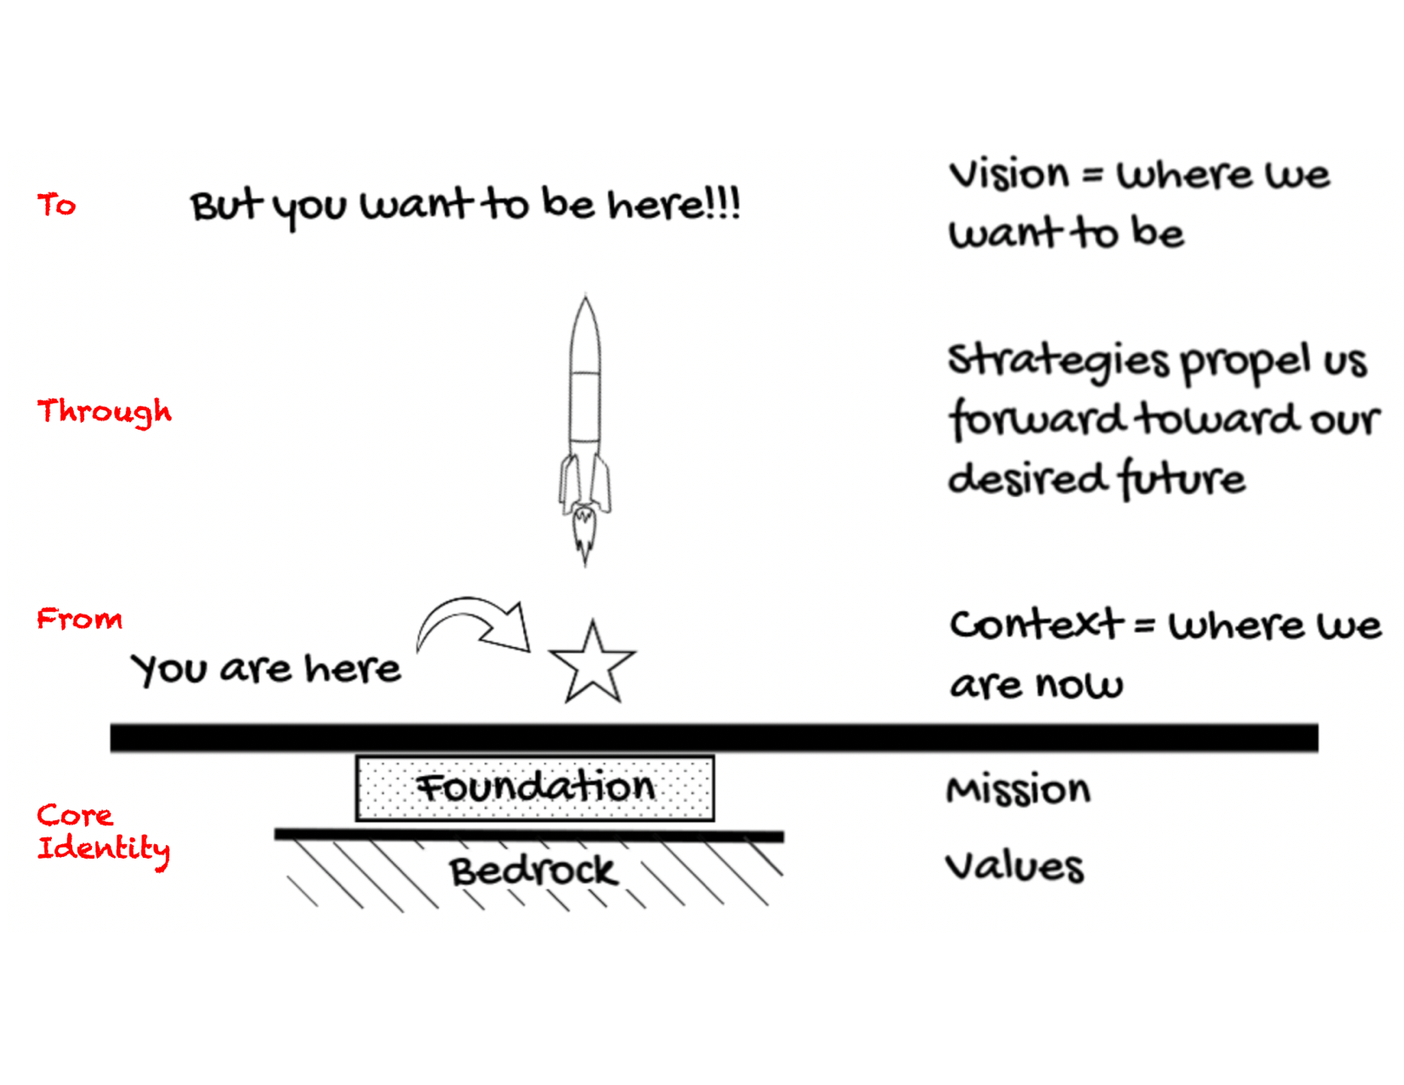

Slide 58
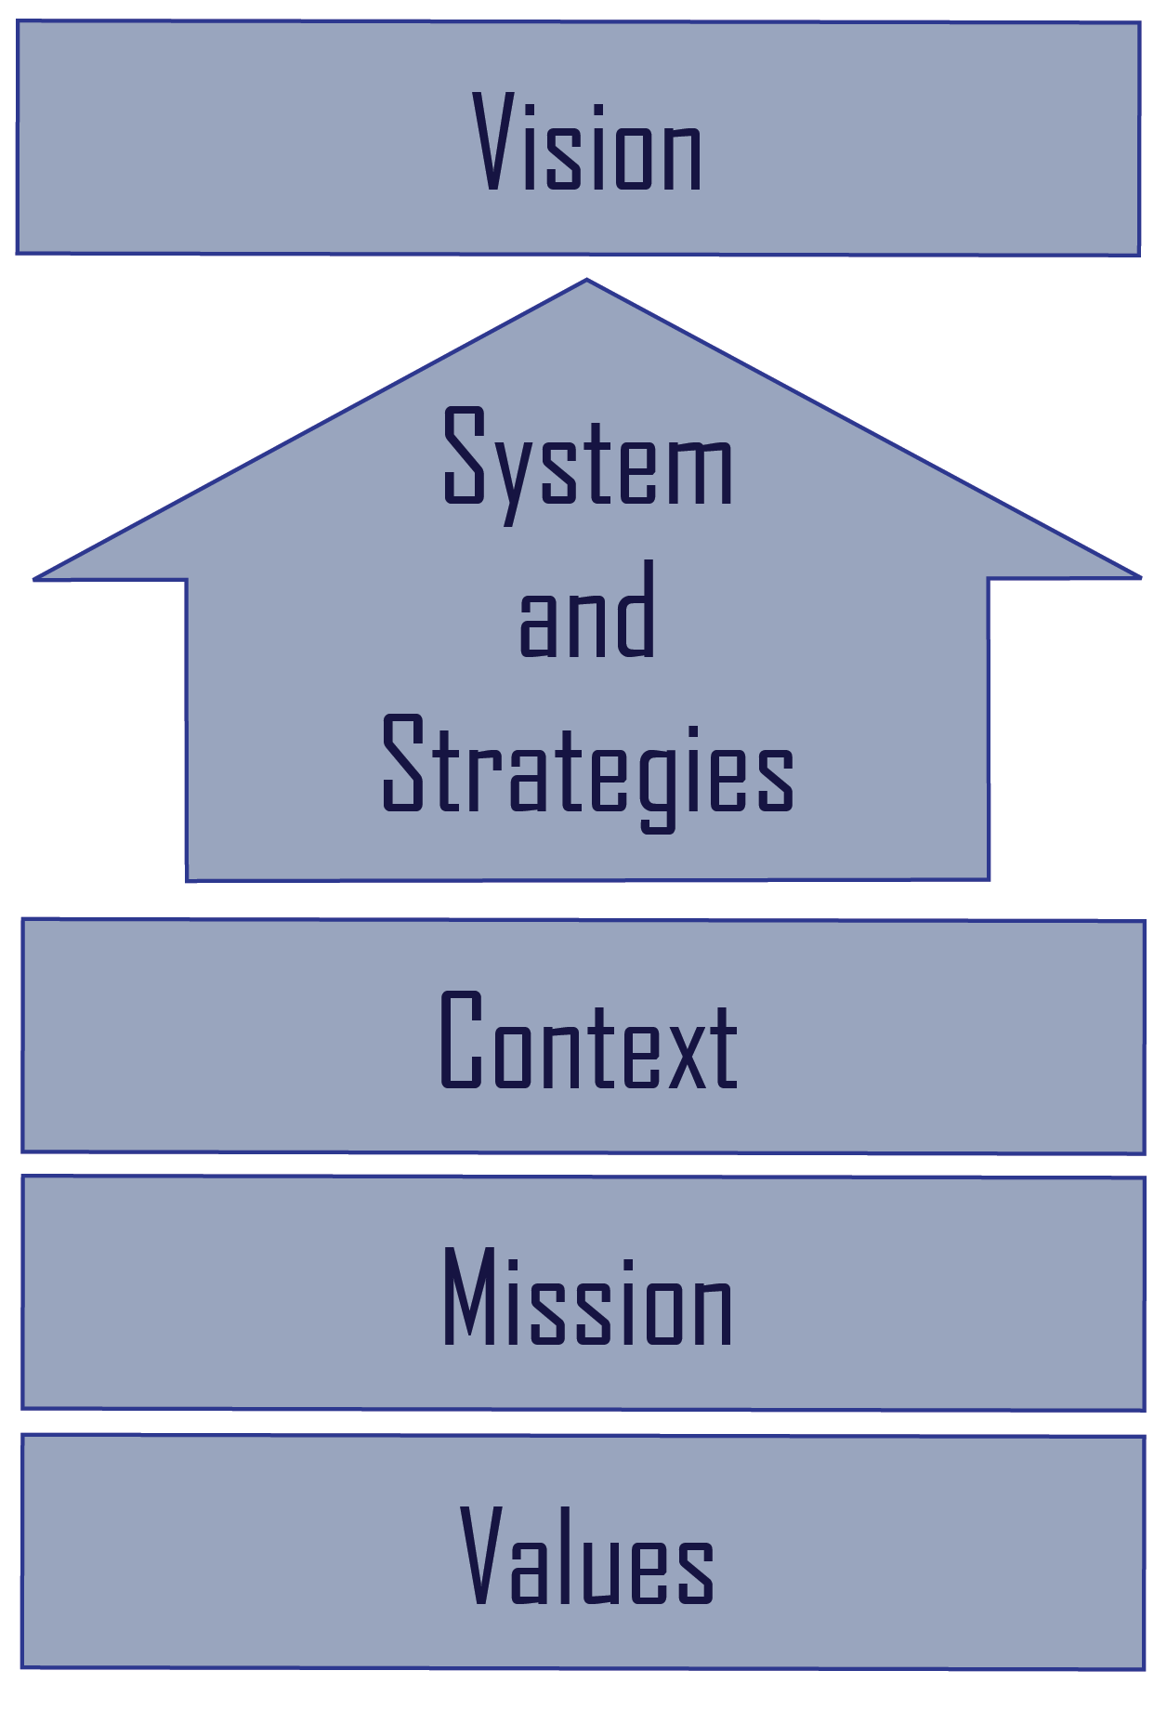
The MAP is a Story of Change
Where are we going?
How do we get there?
Where are we today?
Foundation
Notes:
*
Facilitator Notes:
This slide is here to help in reviewing where we are headed and the parts that involved in getting there.
Start at the bottom and let the team members explain each piece – this will give you an idea of where they are in understanding
The concepts in this presentation are the intellectual property of Spiritual Leadership Inc., except as noted otherwise.
Copyright © 2016 Spiritual Leadership, Inc. All Rights Reserved.

Slide 59
1-page MAP
Place summaries of MAP components into 1-page format
Practice telling your ministry’s story using this MAP
Notes:
Facilitator Notes
Make copies of the 1-page MAP blank template and the 1-page MAP guidelines (a copy of which is on the following slide to project to the group).
Using the guide and having the team take notes on their blank copy, lead them as quickly as they can manage through this process. As usual, don’t give them answers but have some in your pocket to suggest in case they get stuck.
Goal: capture the essence of all the dialog around each area since the journey began, but do so in one short sentence or 2-3 bullets wherever possible. Ask questions in this direction: “What are the 2 most important insights we’ve discovered about our current context?” or “We haven’t nailed down a vision statement yet, but what 2-3 key phrases or thoughts reflect our common picture of the future?”
Note: Values is the one area not easily amenable to the 2-3 bullets approach. Capture instead the best ‘short list’ of values the team has come up with so far, or at least a reflection of the dialog and lists to date.
Timeframe: the 30 min. time limit is meant to be very flexible – it’s there to let the team know we’re not just talking about topics now, we’re remembering, summarizing, and getting it down quickly.
Do not leave this meeting without a 1-page MAP in hand! And do this even if you had not written anything down at all until now! The team has been talking about these things each time, even if they haven’t organized the dialog by topic at the time. Help the team see they’ve got a lot more of their MAP pretty well discerned by now than they probably think they have. This exercise will not only be very practical for them but should also give them a sense of accomplishment and a sense that things are getting clearer now than they may have seemed so far.
The concepts in this presentation are the intellectual property of Spiritual Leadership Inc., except as noted otherwise.
Copyright © 2016 Spiritual Leadership, Inc. All Rights Reserved.

Slide 60
Where is God leading us?
How will we get there?
Where are we now…really?
Why do we exist?
What is too important to compromise?
Notes:
Facilitator Notes
Developing their MAP (Ministry Action Planning) answering (from the bottom up):
What is important too important to compromise?
Why do we exist?
Where are we now…really?
Where is God leading us?
How will we get there?
This is an introductory slide to the MAP (Ministry Action Plan) Don’t get caught up in trying to explain the complexity of the MAP, but rather paint a broad stroke picture of the process and the key 5 questions at this point. Reassure them that they will have time and good instruction/learning about each of these as the process continues. Each of these sections (Context, Vision, Focus, Systems/Strategies) have a specific Learning component.
The Ministry Action Plan is a simple format. There are just 5 different key areas: building the right type of team, understanding the context or the existing reality, knowing what your focus is, building a system to reach towards a vision, and then putting it into practice.
Spend a few minutes actually answering the questions as it relates to their ministry. Again, paint the picture that together they will discern the answers to these questions, but do not have to have the answers at this point.
The concepts in this presentation are the intellectual property of Spiritual Leadership Inc., except as noted otherwise.
Copyright © 2016 Spiritual Leadership, Inc. All Rights Reserved.

Slide 61
Ministry Action Plan (MAP)
Notes:
The concepts in this presentation are the intellectual property of Spiritual Leadership Inc., except as noted otherwise.
Copyright © 2016 Spiritual Leadership, Inc. All Rights Reserved.

Slide 62
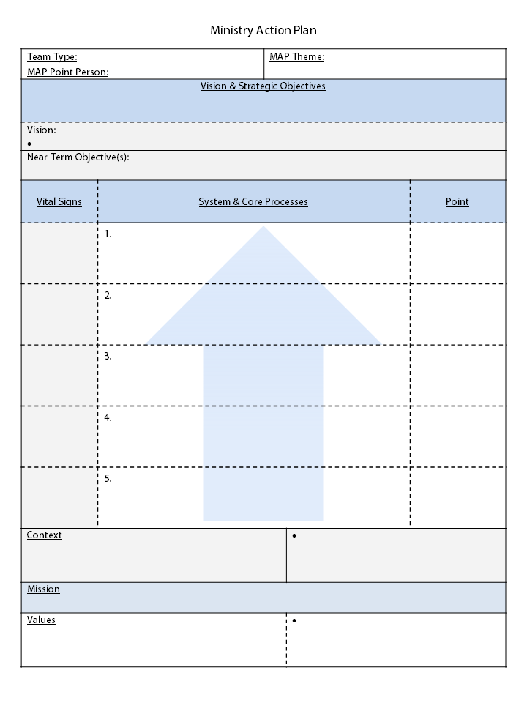
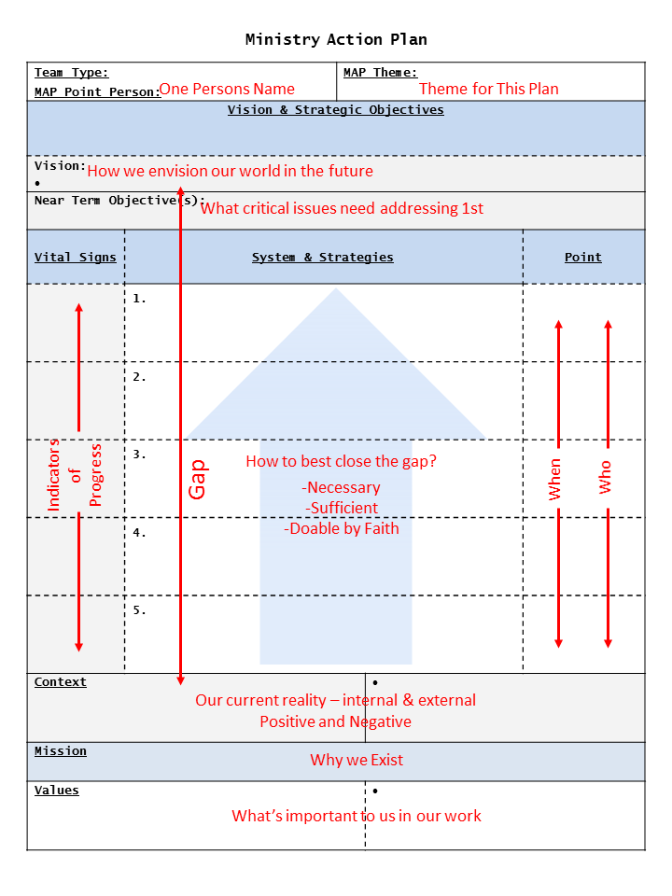
Ministry Action Plan (MAP)
Notes:
Facilitator Notes
Background:
This guide is intended to clarify for teams the various parts and pieces of their MAP and how they relate to each other. It uses everyday terminology.
What is included on the 1-page MAP summary is the core of each component – Context, Focus (values, mission, vision), and Strategy, with keys to its implementation within the Systems & Strategy section. In addition, the components are arranged visually to reflect their relationship with each other: First, the values and mission are at the bottom, forming a foundation on which the rest is built. The context is next, and it relates directly to the vision way above it, illustrating the gap between the two and the need to fill in that gap productively through strategies – actions addressing ‘How best to close the Gap?’
Other features included here should inform and guide the implementation of these strategies. That is, for each main area of strategy, which one person is responsible for it is named in the “Point” column, a date by which that person commits to have it completed is given in the ‘Dates’ column, and what markers or Vital Signs will tell us the strategy is working and bearing fruit. In essence, these columns answer two key questions the team should become used to asking all the time: “Who will do what by when?” and “How will we know it’s working?”
At the top, the ‘Point’ for the entire MAP and its team is named, along with a title or name for the MAP itself.
Finally, in the Vision block, there is also a place for ‘Near Term Objective(s).’ By the time a team reaches the point of drafting this summary, it very likely will have discerned one or two critically important areas of focus that will need major effort. Examples might be the congregation developing a deeper commitment to becoming true disciples, or moving from an internally focused mindset to an externally focused one. These need to be captured and held up whenever the vision is brought up – as key initiatives that need lots of attention and which will drive many decisions in the near future. It is expected that a near term objective will help focus the strategies beneath it and will help generate key strategies themselves.
Script:
First Draft:
To help the team draft this summary the first time, don’t hesitate to be directive. Drive the group from any previous ‘meanderings’ around various topics to spend just a few moments capturing the key points they keep coming back to during discussions. Even if the team has not been faithful in writing down their previous observations, they should still be able to capture a few essential points to come up with a first draft in quite a short time. We suggest focusing the team to the task by giving them 30-45 minutes to finish this draft. Each MAP component should answer the questions on the guide, and these answers should be brief and as clear as feasible. For example, in context, there should be perhaps 1-2 phrases or brief sentences on internal context – positive and negative, and external context – positive and negative. Keep asking what are the key points and keep the team ‘out of the weeds’ here – just quickly naming key points, writing them down, and moving on, placing any distracting topics in ‘the parking lot’ for bringing back at a later date.
By the end of this exercise, stand back for a moment and have the team reflect on what they have – does it paint an energizing, compelling picture of what needs to happen and why? If it falls a bit short of that, ask what’s missing and talk that through for a moment. If that issue will take longer than, say, 10-15 minutes, put it on the next meeting’s agenda. But it’s likely this exercise will be very encouraging to the team, to see they’ve really got something tangible from all the previous discussions and they’re either ready or very close to ready to do something specific with all this previous work!
Subsequent Meetings:
This 1-page MAP should become the ‘working paper’ for the entire team from now on. In the Planning Track, it can be used to discern which component(s) still need deeper understanding, more research, better articulation, and thus guide the choice of the next MAP topic to improve. For Implementation, those responsible for strategy should be asked how they’re doing with the specifics in their area, performing a regular RAD (Reflect, Adjust, Do) on their Missional Accountability. For Communication, next steps can also be discerned by reference to the MAP itself and how well it is being received, adopted, or resisted.
In short, the MAP, once developed even in a sketchy draft, becomes the ‘driver’ for leading the congregation forward in a well discerned and well focused manner.
The concepts in this presentation are the intellectual property of Spiritual Leadership Inc., except as noted otherwise.
Copyright © 2016 Spiritual Leadership, Inc. All Rights Reserved.

Slide 63
Discernment & Sanctification
Reflect
Adjust
Do
Getting it “right” is secondary to getting started and continual improvement!
Notes:
Facilitator notes
The incubator process is designed to help leaders move from planning once in awhile to fostering a continuous improvement or learning environment. The cycle repeats over and over again checking adjusting and doing.
The version 3 incubator will be attempting to move through this cycle twice during the year long process.
Stories
References
Copyright- This slide comes from the design or experience of SLI – © 2009 Spiritual Leadership, Inc.

Slide 64
Key Actionable Questions
Team Questions
Spiritual Formation Questions
Ministry Action Planning Questions
Progress
Questions
Team
Team leadership?
Gifts Based?
Covenant to guide behavior?
Accountability?
Spiritual Formation
Spiritual Growth in Community?
Growth led by the Spirit?
Accountability?
Learning
Questions
Learning Questions
Goal?
Plan?
Working and why?
Change?
Planning
Mission?
Most important?
Current Reality?
Future vision?
Action Steps to Future?
Progress
Measures of progress?
Who is responsible & Accountable to whom?
When?
Notes:
Purpose of Slide: To help see SLI’s approach through the lens of questions
Messages of Slide:
There are 5 buckets of questions: Team, Spiritual Formation, Planning, Progress and Learning
Which of these should be the most important?
“We can agree upon spiritual formation can we not?” (Learning is another candidate for most important for if that was really strong the team would realize they weren’t mature enough spiritually)
“Then why is it not first?” “Because our approach to spiritual growth is Wesleyan in that it is in community where we grow spiritually. People will not open up to each other without a growing sense of team.
The concepts in this presentation are the intellectual property of Spiritual Leadership Inc., except as noted otherwise.
Copyright © 2016 Spiritual Leadership, Inc. All Rights Reserved.

Slide 65
Key Leadership Questions
Team Questions
Team Leadership - Have we accepted the notion that Biblical leadership is team and gift based vs solo heroic based?
Gift based - Have we staffed the team based on gifts?
Covenant - Have we defined how we want to behave and interact as a team?
Accountability - Are we being accountable in living into this?
Team Questions
Notes:
Purpose of Slide: To expand on the one page version in the area of leadership
Messages of Slide:
This set of questions guides us to the important elements for the selection team members and their initial formation as team.
Key elements are giftedness and strengths, commitment of Covenant relationship, and accountability to the covenant.
These are essential for the team in order for there to be deep commitment and diverse gifts and strengths to embrace and accomplish the work of transformation.
The concepts in this presentation are the intellectual property of Spiritual Leadership Inc., except as noted otherwise.
Copyright © 2016 Spiritual Leadership, Inc. All Rights Reserved.

Slide 66
Key Leadership Questions
Spiritual Formation Questions
Growth in Community - Are we committed to growing spiritually together in community?
Growth led by the Spirit - Where do you sense the Holy Spirit is asking you to grow more like Christ?
Accountability - How would you like the team to hold you accountable for spiritual growth?
Spiritual Formation Questions
Notes:
Purpose of Slide: To expand on the one page version in the area of spiritual formation
Messages of Slide:
The Spiritual Formation questions engage the team participants in a community of faith deeply committed to living out a relationship that both deepens their personal spirituality and forms the team into a spiritual based leadership community learning to lead in transformational ways.
This includes a disciplined practice of discerning the movement of the Holy Spirit in their desire to grow more like Christ in their personal and leadership roles.
Accountability to the commitments participants make concerning their spiritual disciplines, and to the team, creates cohesiveness through spiritual growth in community.
The concepts in this presentation are the intellectual property of Spiritual Leadership Inc., except as noted otherwise.
Copyright © 2016 Spiritual Leadership, Inc. All Rights Reserved.

Slide 67
Key Leadership Questions
Ministry Action Planning Questions
Mission - What is the ministry's mission or purpose
Why does this team exist?
Values - What's most important with regard to that purpose or how we achieve that purpose?
Context - What is the current/brutally honest reality of where we are vs this purpose?
Ministry Action Planning Questions
Vision - Where do we want to be 3 to 5 years into the future w/r to the purpose?
Strategies - What steps do we plan to take or how are we going to achieve the vision?
Notes:
Purpose of Slide: To expand on the one page version in the area of planning
Messages of Slide:
The 5 MAP questions lead the team to develop a plan of action that is focused on the Ministry Action Plan elements of Values, Mission, Context, Strategies and Vision.
This is the Fulcrum which creates leverage for all the resources, energy, and effort of the team to fulfill the Mission and move toward the Vision of a fruitful ministry.
The concepts in this presentation are the intellectual property of Spiritual Leadership Inc., except as noted otherwise.
Copyright © 2016 Spiritual Leadership, Inc. All Rights Reserved.

Slide 68
Key Leadership Questions
Progress Questions
Measures of Progress - How will we know if we are making progress?
Who - Who is responsible for seeing an action through?
To whom are we accountable?
When – By when does it need to be done?
Progress
Questions
Notes:
Purpose of Slide: To expand on the one page version in the area of making progress
Messages of Slide:
These action questions push all the work at the prior levels toward actual implementation and actions that move the church forward in it’s ministry.
Without answering these questions of who, when and how to know if we are making progress then nothing will come of the plan (the previous 5 questions)
The concepts in this presentation are the intellectual property of Spiritual Leadership Inc., except as noted otherwise.
Copyright © 2016 Spiritual Leadership, Inc. All Rights Reserved.

Slide 69
Key Leadership Questions
Learning and Improving Questions
Goal - What is our goal?
Plan - What is the plan to get there?
Working – How is it working for us and why?
Change – What are we going to do differently or experiment with?
Learning
Questions
Notes:
Purpose of Slide: To expand on the one page version in the area of making progress
Messages of Slide:
These questions in the RAD drives for continual learning to move through adaptive issues and keeps the work focused, action oriented, and dynamic as the team leads the organization into the future.
The idea of deep learning about our assumptions, our values, our beliefs, etc. can only come through trust. This trust comes about because of the L3 approach and the spiritual growth focus
The concepts in this presentation are the intellectual property of Spiritual Leadership Inc., except as noted otherwise.
Copyright © 2016 Spiritual Leadership, Inc. All Rights Reserved.

Slide 70
3 Types of Accountability
Formational
Relational
Missional

Slide 71
MAP Questions
3 Core Planning Questions
From Here (Context)
To There (Vision)
Getting There (Strategies)
2 Critical Planning Questions
Mission
Values
3 Progress Questions
Who
When
How Measure

Slide 72
8 Questions of a MAP
Ministry Action Planning Questions
Mission - What is the ministry's mission or purpose
Values - What's most important with regard to that purpose or how we achieve that purpose?
Context - What is the current/brutally honest reality of where we are vs this purpose?
Vision - Where do we want to be 3 to 5 years into the future w/r to the purpose?
Strategies - What steps do we plan to take or how are we going to achieve the vision?
Progress Questions for each Strategy
Measures of Progress - How will we know if we are making progress?
Who - Who is responsible for seeing an action through?
To whom are we accountable?
When – By when does it need to be done?

